Slide 1

Introduction Stats
for Machine Learning
Case Study: What's process behind the R lm() function??
Oleh:
Safiera Nurul Valen
Devina Gilar Fitri Ayu Sumardi
in/safiera-nurul-valen/
in/devina-gilar-fitri-ayu-sumardi-940954150/

Slide 2
Materials
01
Introduction
02
Case Study
03
Practice
04
Conclusion

Slide 3
PROBLEM
STATISTIKA
MACHINE LEARNING
WHY

Slide 4

Machine Learning
WHAT IS ???
Applications from artificial intelligence (AI) that use statistical techniques to produce an automatic model of a set of data with the aim of giving computers the ability to "learn"

Slide 5
WHAT IS ???
Science or art that studies how to plan,
collect,
analyze,
interpret, and give a conclusion from data
Statistics
Statistics Descriptive,
summarize data
Statistics Inferens,
draw conclusions from sample data to represent the population
Machine Learning

Slide 6

DIFFERENCE MINDSET
STATISTIKA
- Theory
- Hypothesis and Asumption
MACHINE LEARNING
- The algorithm performance for model estimation
- Faster development model
- Big Data

Slide 7
HOW IMPORTANT STATISTICS IN MACHINE LEARNING
Statistics in Data Preparation
1
preparation of train & testing data for your machine learning model
2
Statistics in Model Evaluation
evaluating the skill of machine learning model on data not seen during training
3
Statistics in Model Selection
Selecting a final model to use for a predictive modeling problem
4
Statistics in Model Presentation
Presenting the skill of a final model to stakeholder
5
Statistics in Prediction
Selecting a final model to use for a predictive modeling problem

Slide 8
What's process behind the R lm() function??

Slide 9
STUDY CASE
LINEAR REGRESSION
The concept of regression analysis deals with finding the best relationship between Y and x, quantifying the strength of that relationship, and using methods that allow for prediction of the response values given values of the regressor x.

Slide 10
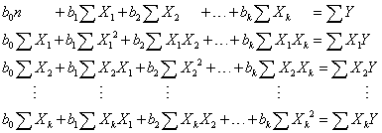
Basic from OLS (Linear Regression)

Slide 11
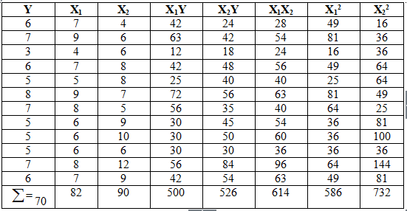
Case Study
Y = Banyak Penjualan Novel
X1 = Banyak Penyebaran Brosur di Universitas
X2 = Banyak Penyebaran Brosur di Sekolah Menengah

Slide 12

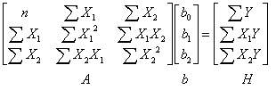
Equation and Matrix for 2 Variables

Slide 13
Data Preparation

Slide 14
Data Preparation
Tutorial
http://bit.ly/intro-stats-for-ML

Slide 15
Data Preparation
> Y=sum(data$Y)
Tutorial
http://bit.ly/intro-stats-for-ML

Slide 16
Data Preparation
> X1=sum(data$X1)
Tutorial
http://bit.ly/intro-stats-for-ML

Slide 17
Data Preparation
> X2=sum(data$X2)
Tutorial
http://bit.ly/intro-stats-for-ML

Slide 18
Data Preparation
> n=dim(data)[1]
> X1Y=numeric(n)
> for(i in 1:n){
+ X1Y[i]=data$X1[i]*data$Y[i]}
> X1Y=sum(X1Y)
Tutorial
http://bit.ly/intro-stats-for-ML

Slide 19
Data Preparation
> X2Y=numeric(n)
> for(i in 1:n){
+ X2Y[i]=data$X2[i]*data$Y[i]}
> X2Y=sum(X2Y)
Tutorial
http://bit.ly/intro-stats-for-ML

Slide 20
Data Preparation
> X1X2=numeric(n)
> for(i in 1:n){
+ X1X2[i]=data$X1[i]*data$X2[i]}
> X1X2=sum(X1X2)
Tutorial
http://bit.ly/intro-stats-for-ML

Slide 21
Data Preparation
> X12=numeric(n)
> for(i in 1:n){
+ X12[i]=data$X1[i]^2}
> X12=sum(X12)
Tutorial
http://bit.ly/intro-stats-for-ML

Slide 22
Model Regression
Tutorial
http://bit.ly/intro-stats-for-ML

Slide 23






Calculate b₀, b₁, b₂
Tutorial
http://bit.ly/intro-stats-for-ML

Slide 24
Calculate b₀, b₁, b₂
>A1=matrix(c(Y,X1,X2,X1Y,X12,X1X2,X2Y,X1X2,X22), nrow=3, byrow=T)
>det(A1)/det(A)
>A=matrix(c(n,X1,X2,X1,X12,X1X2,X2,X1X2,X22), nrow=3, byrow = T)
Tutorial
http://bit.ly/intro-stats-for-ML

Slide 25
Calculate b₀, b₁, b₂
>det(A2)/det(A)
>A2=matrix(c(n,Y,X2,X1,X1Y,X1X2,X2,X2Y,X22), nrow=3, byrow=T)
Tutorial
http://bit.ly/intro-stats-for-ML

Slide 26
Calculate b₀, b₁, b₂
>det(A3)/det(A)
>A3=matrix(c(n,X1,Y,X1,X12,X1Y,X2,X1X2,X2Y), nrow=3, byrow=T)
Tutorial
http://bit.ly/intro-stats-for-ML

Slide 27
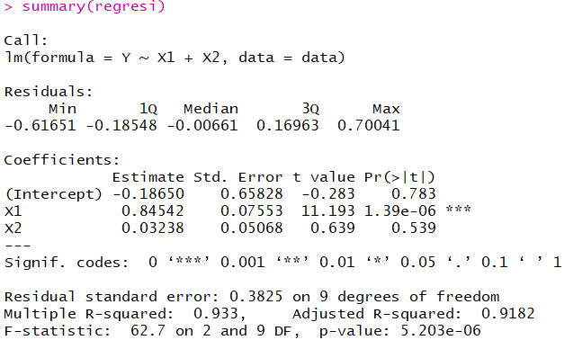
R lm() Function
> regresi=lm(Y~X1+X2, data=data)
> summary(regresi)
Tutorial
http://bit.ly/intro-stats-for-ML

Slide 28
R lm() Function
Uji Overall
H₀ : Tidak terdapat variabel X yang berpengaruh secara signifikan terhadap variabel Y
H₁ : Minimal terdapat 1 variabel X yang berpengaruh secara signifikan terhadap variabel Y
Uji Parsial
H₀ : Koefisien variabel X tidak berpengaruh secara signifikan terhadap variabel Y
H₁ : Koefisien variabel X berpengaruh secara signifikan terhadap variabel Y
Tutorial
http://bit.ly/intro-stats-for-ML

Slide 29
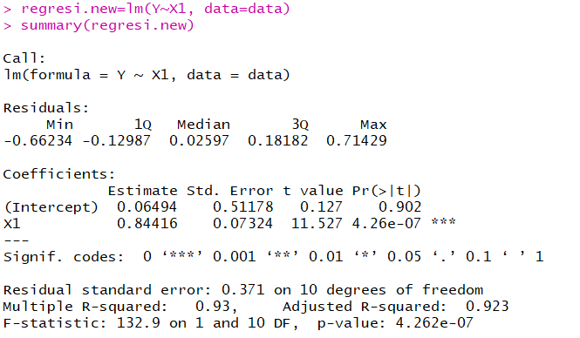
R lm() Function
> regresi.new=lm(Y~X1, data=data)
> summary(regresi.new)
Tutorial
http://bit.ly/intro-stats-for-ML

Slide 30
CONCLUSION
Dalam melakukan analisis harus menggunakan pengujian hipotesis dan asumsi untuk mendapatkan model terbaik
machine learning adalah bagian dari statistika, namun statistika lebih ke arah pengambilan kesimpulan dari sampel yang dapat mewakili populasi, sedangkan machine learning membuat model untuk memprediksi data baru

Slide 31
THANK YOU
ANY QUAESTION ???

